Slide 1
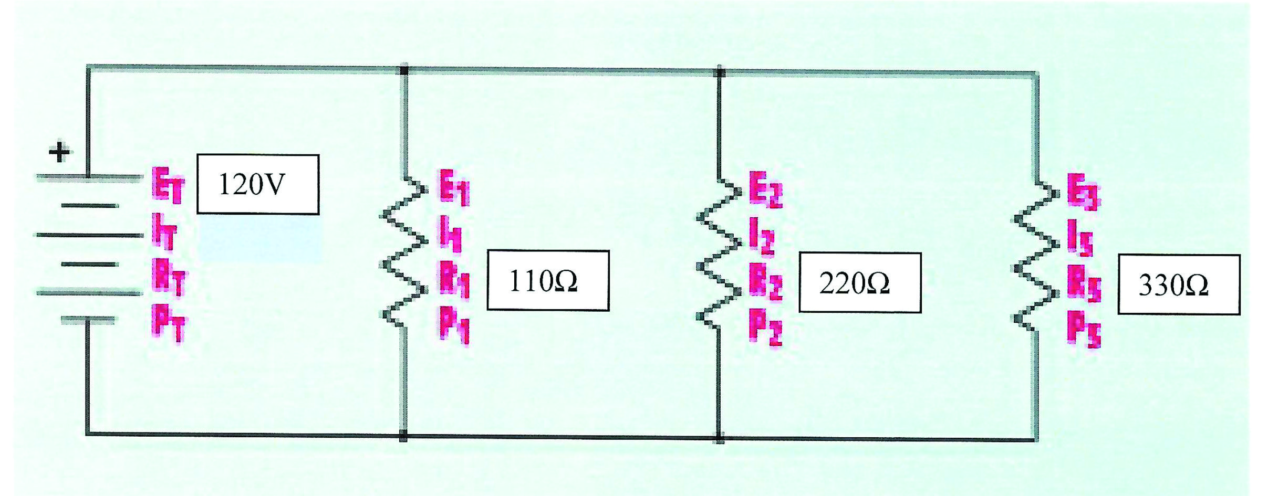
Calculating a parallel circuit

Slide 2
In a parallel circuit
The voltage stays the same but the current changes at each resistor.
We need to find
Total current, total power and current at each resistor and power at each resistor.
You can find total resistance in a Parallel circuit with the following formula: 1/Rt = 1/R1 + 1/R2 + 1/R3 +... If one of the parallel paths is broken, current will continue to flow in all the other paths.

Slide 3
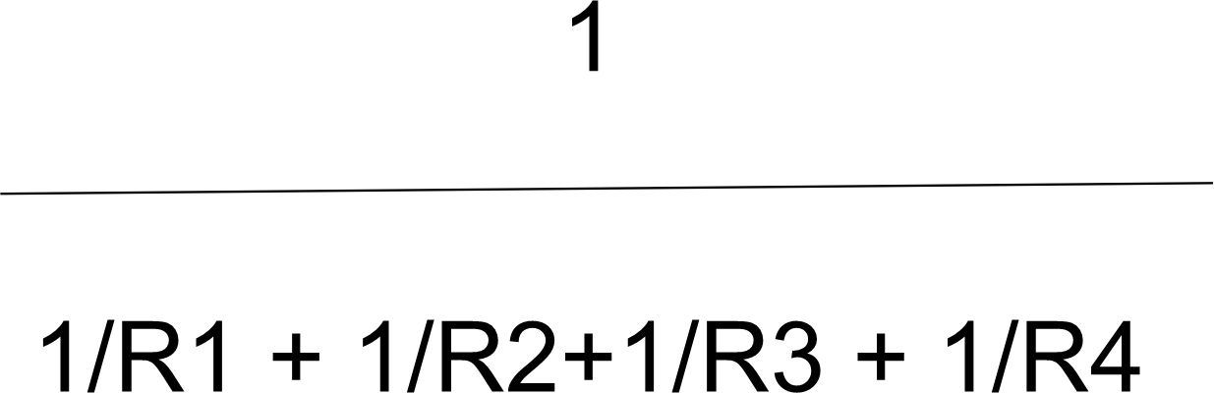
This is the hardest part but once you understand its easy

Slide 4
1/r1=.009
1/r2=.0045
1/r3=.003 add them =.0165 now its 1/.0165=60.6 ohm

Slide 5
Note
The total resistance is always smaller than the smallest resistor in the circuit
We now have 60 ohm total resistance
We know our total voltage which is the same as 120 volt.
We can now calculate the total current which is I=E/R the answer is 2 Amp. And power is P=EXI or 240 watts

Slide 6
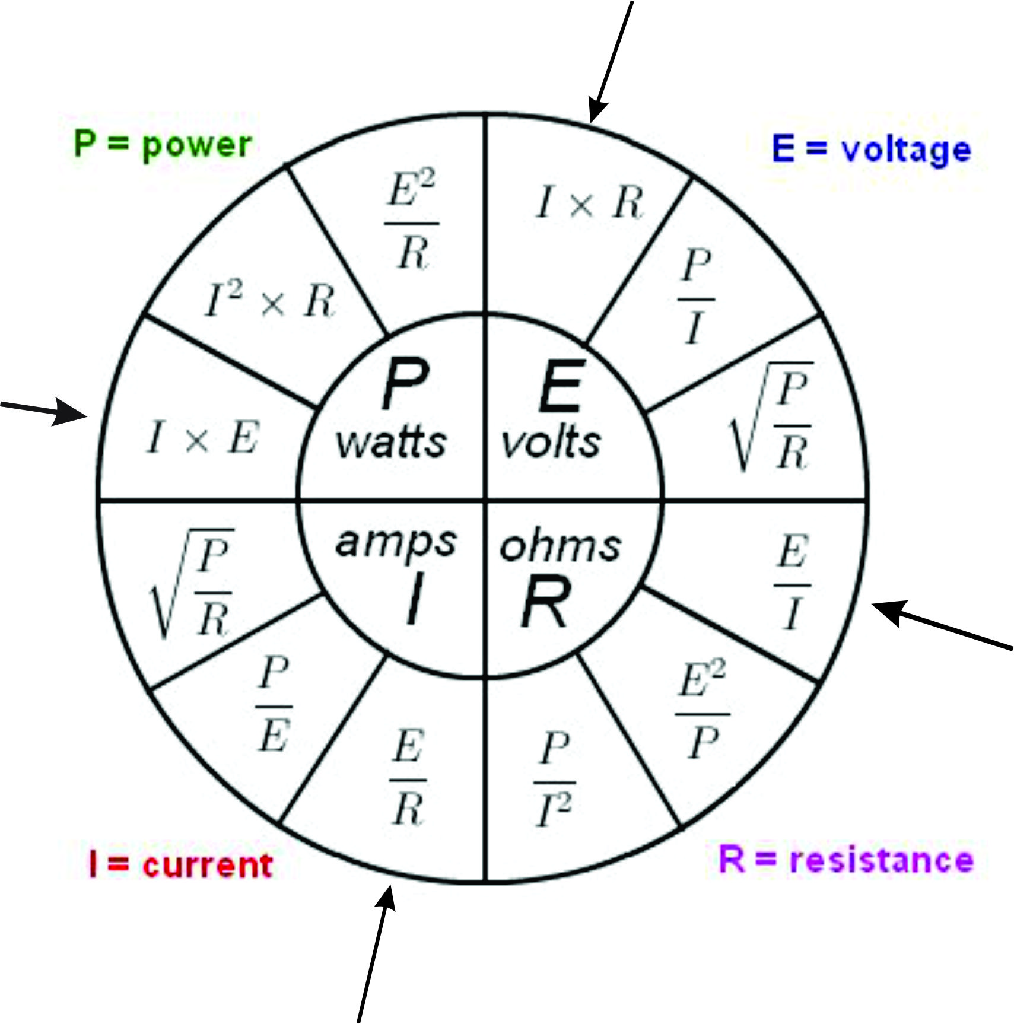
Now calculate the Current at each resistance. Note that the total Currents will add up to the I total so all currents will add up to 2 amp

Slide 7
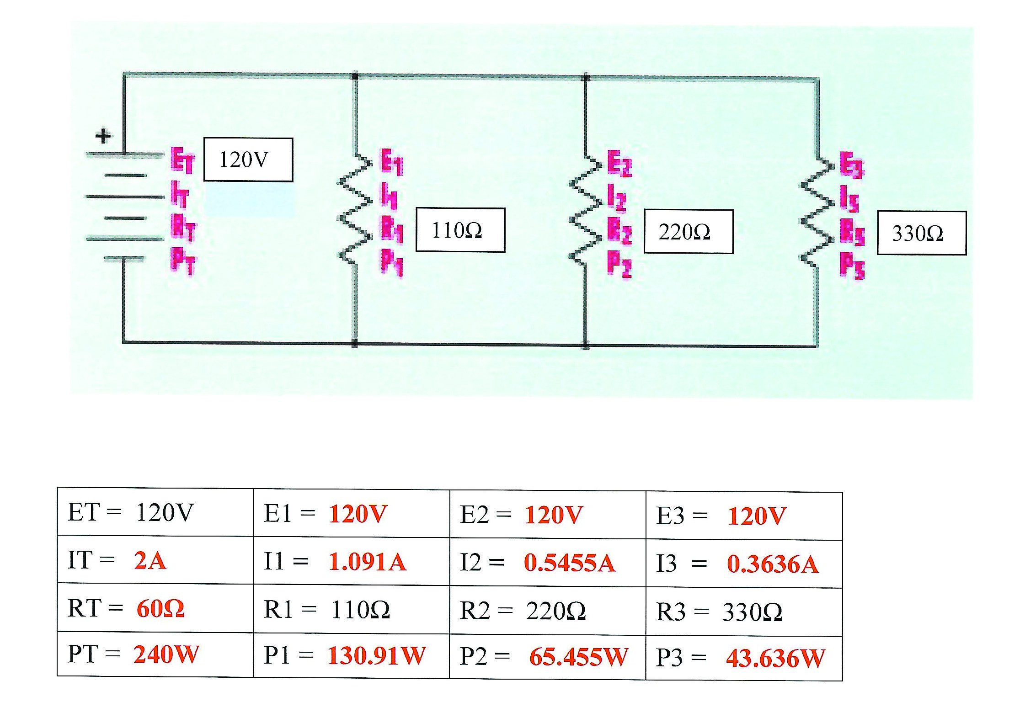
Your results should be..

