Slide 1
Calculating a Series Circuit

Slide 2
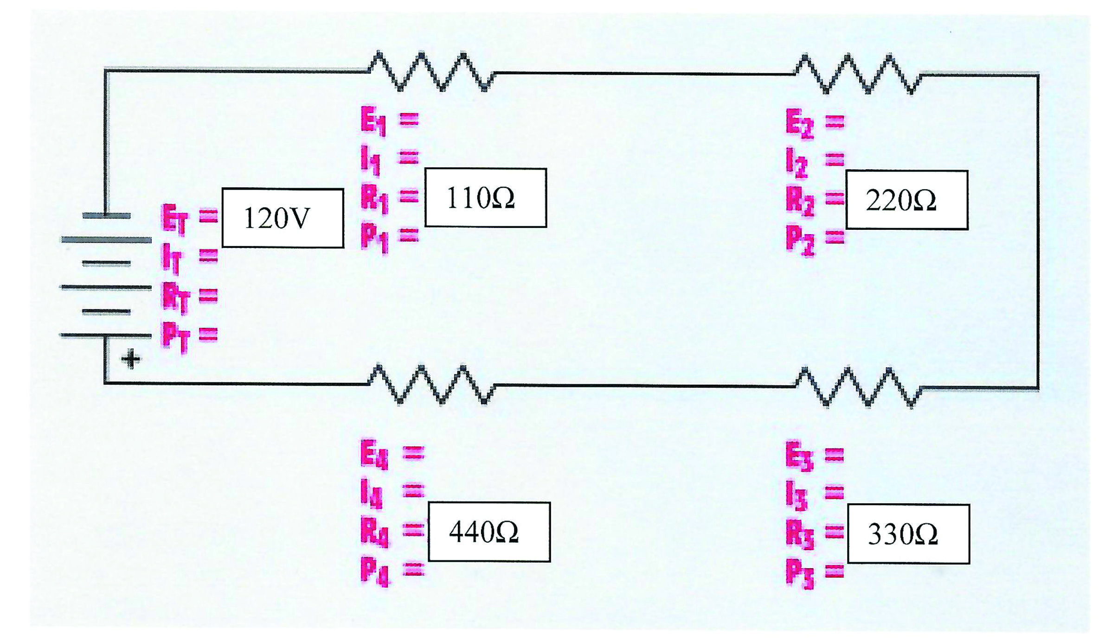
Find the voltage , current ,power and total resistance

Slide 3
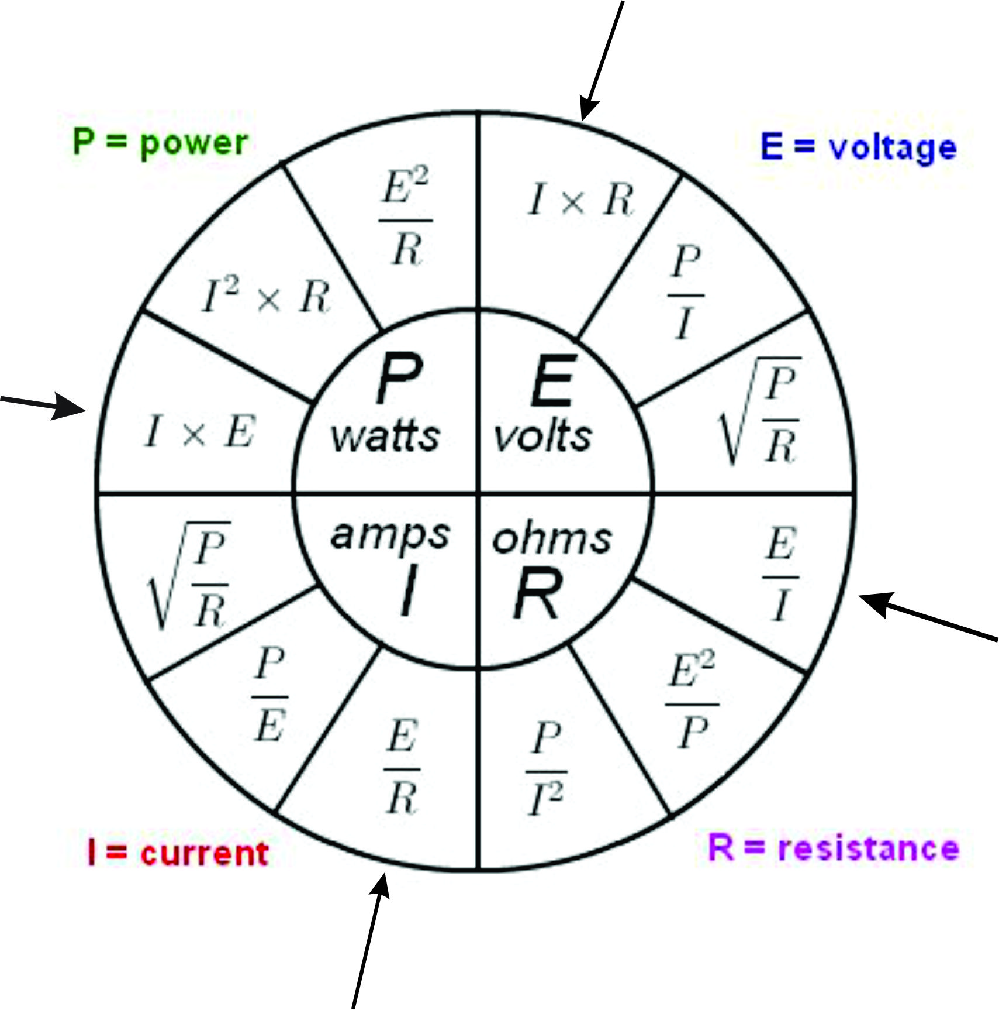
For this exercise we need to know the formula

Slide 4
If we know all the resistances, simply add them up

Slide 5
We add all of them up to get=1100 ohm

Slide 6
Keep in mind..
In a series circuit, the one thing that is common is that the total current travels throughout the entire circuit… so knowing this, we have 1100 ohm and a voltage of 120..
The calculation for calculating current is
I for current is E/R which is approx
.1091 Amp

Slide 7
Now that we have total current and voltage, we can calculate the total Power. The formula is P= I times E or .1091 times 120= 13.091 W

Slide 8
Keep in mind
In a series circuit even though the current is the same throughout, the voltage is not.. Its only at the souce however once it travels through the circuit, it drops a bit at each resistor..
Keep in mind that the total voltage drop will add up to the total voltage. So using ohms law, we use the E or Voltage ( E stands for electromotive force) to calculate .

Slide 9
R1 is 110 ohm and we know the Current to be .1091A therefore if E is I X R the result for R1 is 12.001 V

Slide 10
We can now calculate the power since we now know at least 2 values

Slide 11
Continue with the rest of the resistors and calculate the voltage drops at each resistor, and wattage at each resistor and your answers are????

Slide 12
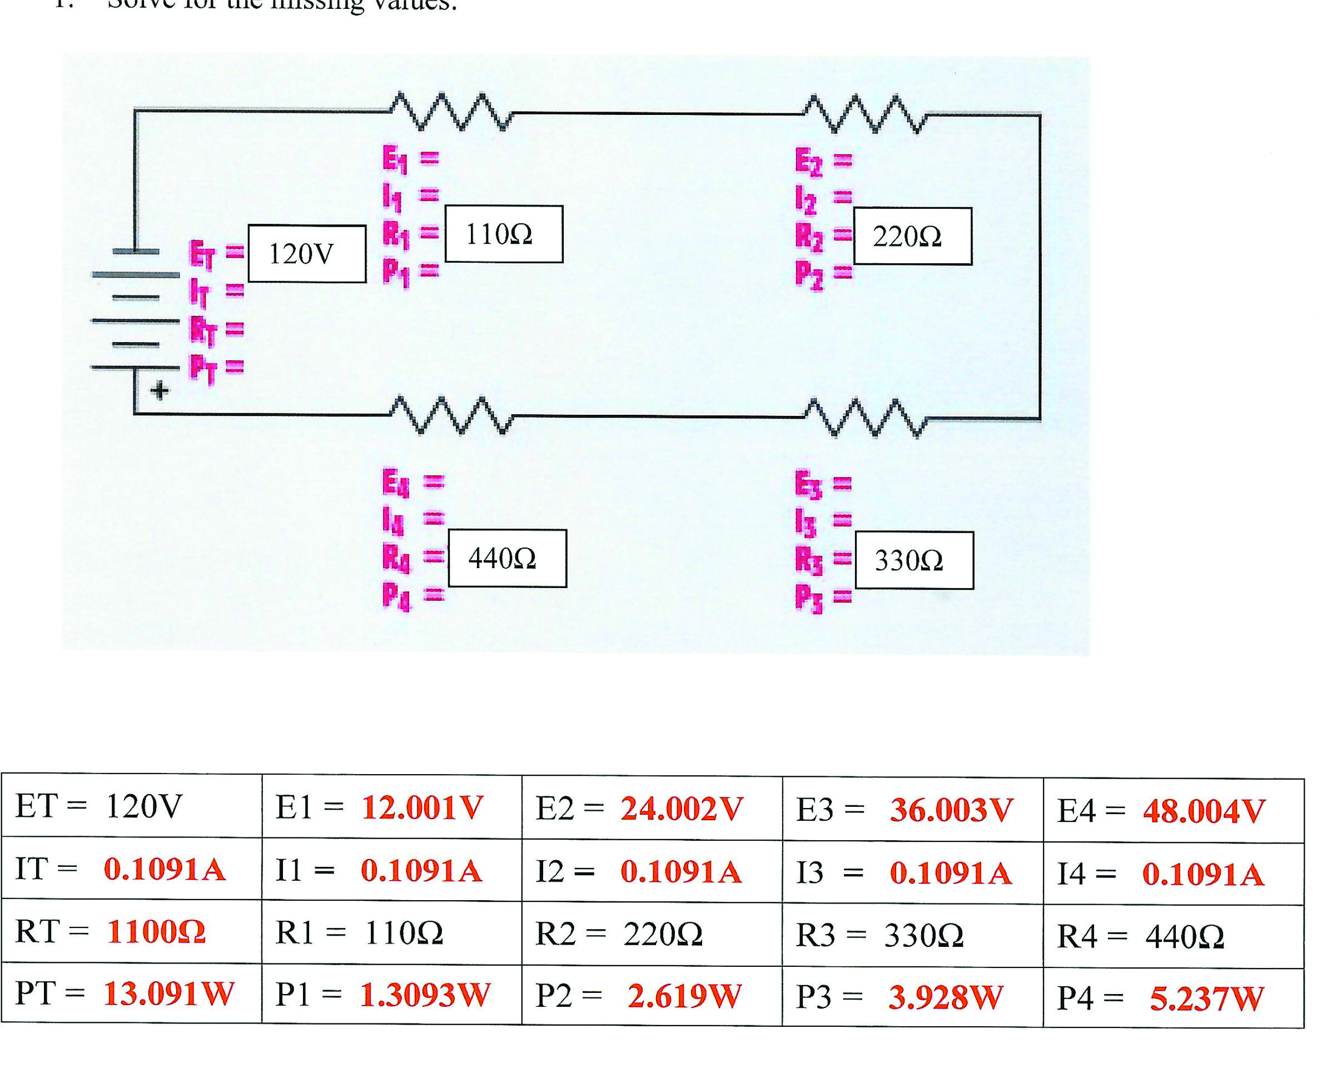
Answer sheet..

