Slide 1
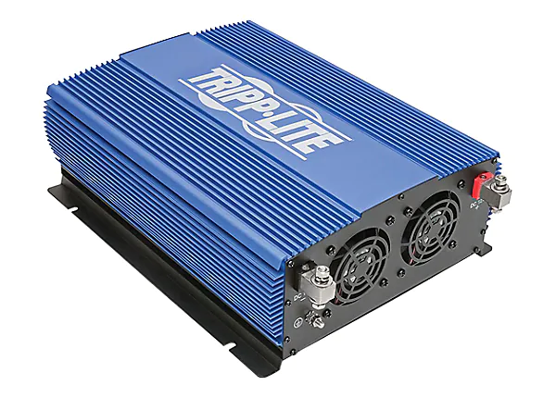
Inverters

Slide 2
An inverter is a device that inverts a dc voltage to an AC voltage
A converter is generally understood to be a device that converts but no inverts..
So a small appliance transformer could be understood to be a converter… please do not confuse the two.

Slide 3
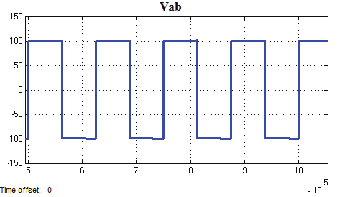
There are generally 3 types of inverters
The Square wave.

Slide 4
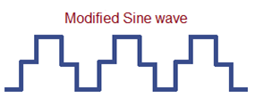
The modified Sine wave

Slide 5
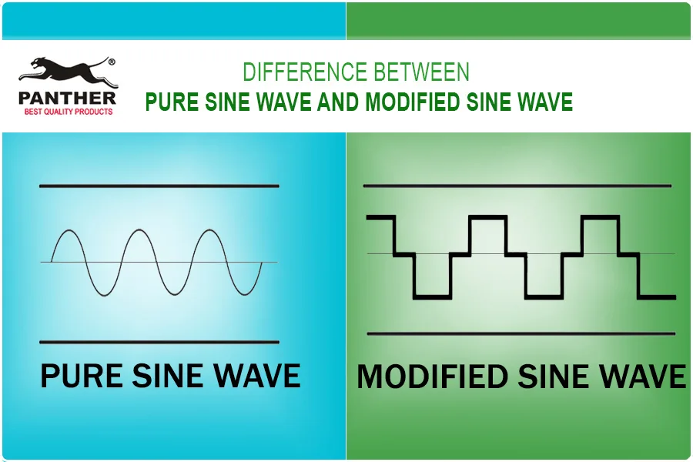
The sine wave

Slide 6
Why the difference???
A Square wave is hardly used anymore..
But it is the cheapest way to come up with some sort of positive/negative wave which could be used by some AC devices.. But not all.

Slide 7
The square wave, even though does generate AC, should be considered a dirty form of sine wave… the hard up and down of the wave will cause the item supplied to hammer the voltage up and down, causing premature failure , noise and overheat.

Slide 8
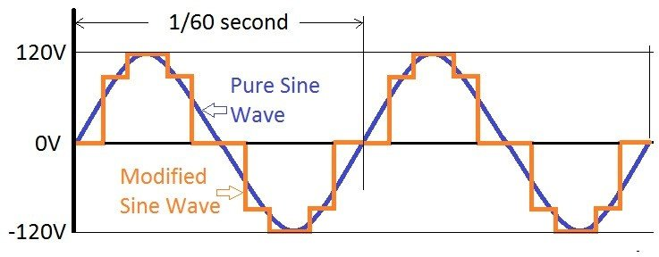
The modified sine wave is electronically induced to mimic the true sine wave

Slide 9
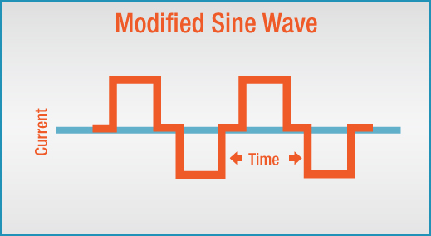
The modified sine wave is much better than the square wave but can still create noise and overheat as well as poor operation in some devices

Slide 10
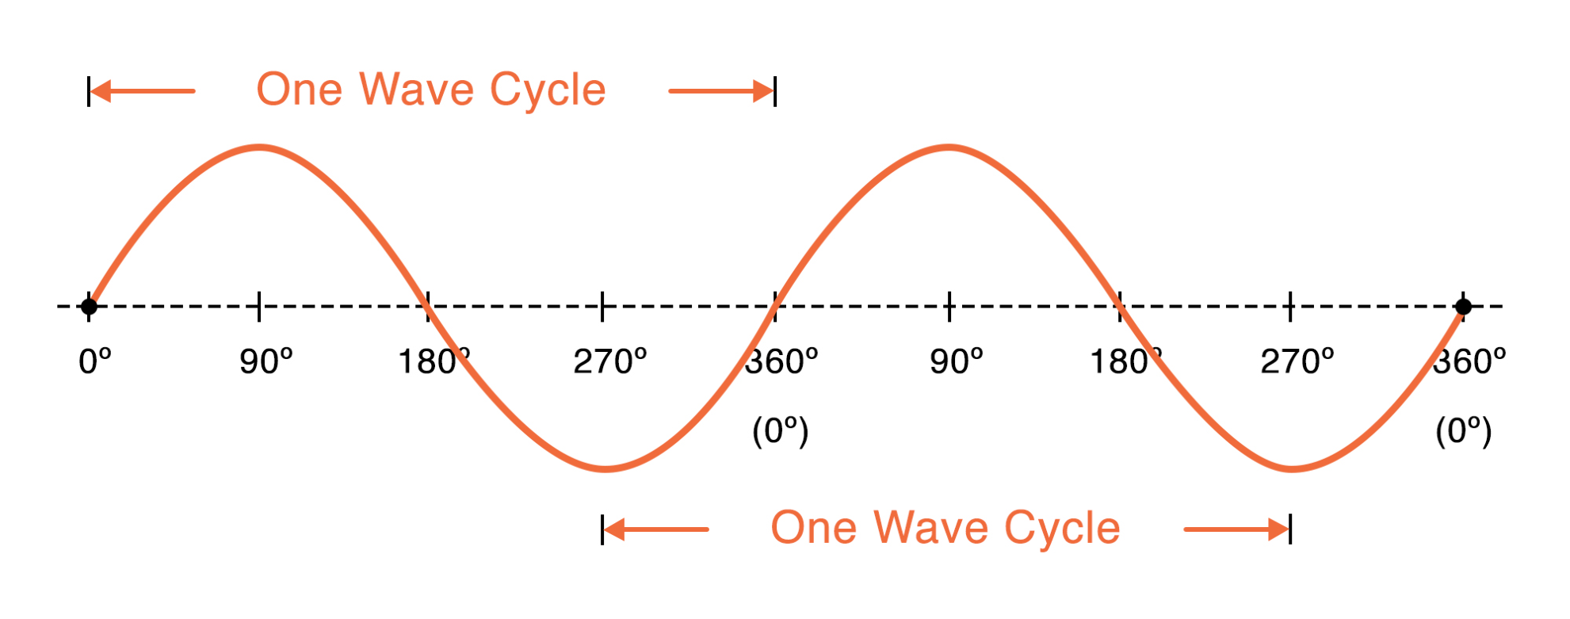
The true sine wave due to its smooth transition allows for a natural wave

Slide 11
The higher the wattage, the more power is used just to run the internal components.

Slide 12
You don’t get something for nothing
Since wattage does not change in a circuit if being transformed.
Consider a 1000 watt microwave for example
1000 watt/120 volt= 8.3 amp
If we run an inverter from batteries, we need to be able to supply the power from the batteries.
1000 watt/12 volt=83 amp

Slide 13
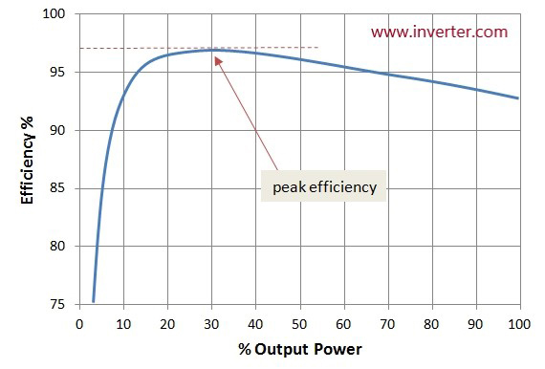
Efficiency
Because power is being inverted within the unit, efficiency drops the more current being drawn. Due to electronic losses and heat.

Slide 14
Grid tried system
On a grid tied system, there are no batteries, not charge controller, only an inverter with Anti Islanding which shuts down your generated power to protect anyone working on the grid in the even of a power failure of the grid

Slide 15
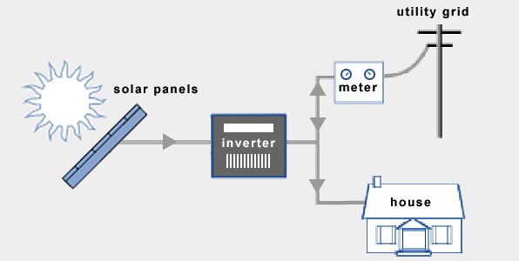
A grid tied system consists of the pv panels up to 240 volt, plus grid tied inverter with anti-islanding and net meter to the grid

