Slide 1
Lab using outdoor lighting
Sun’s photons at work

Slide 2
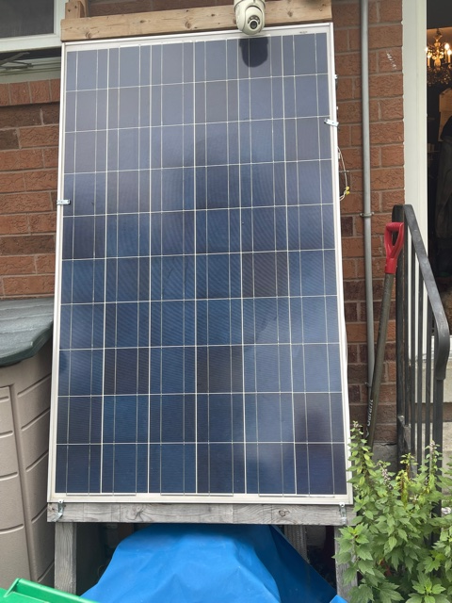
We are using a 230 watt 24 volt panel

Slide 3
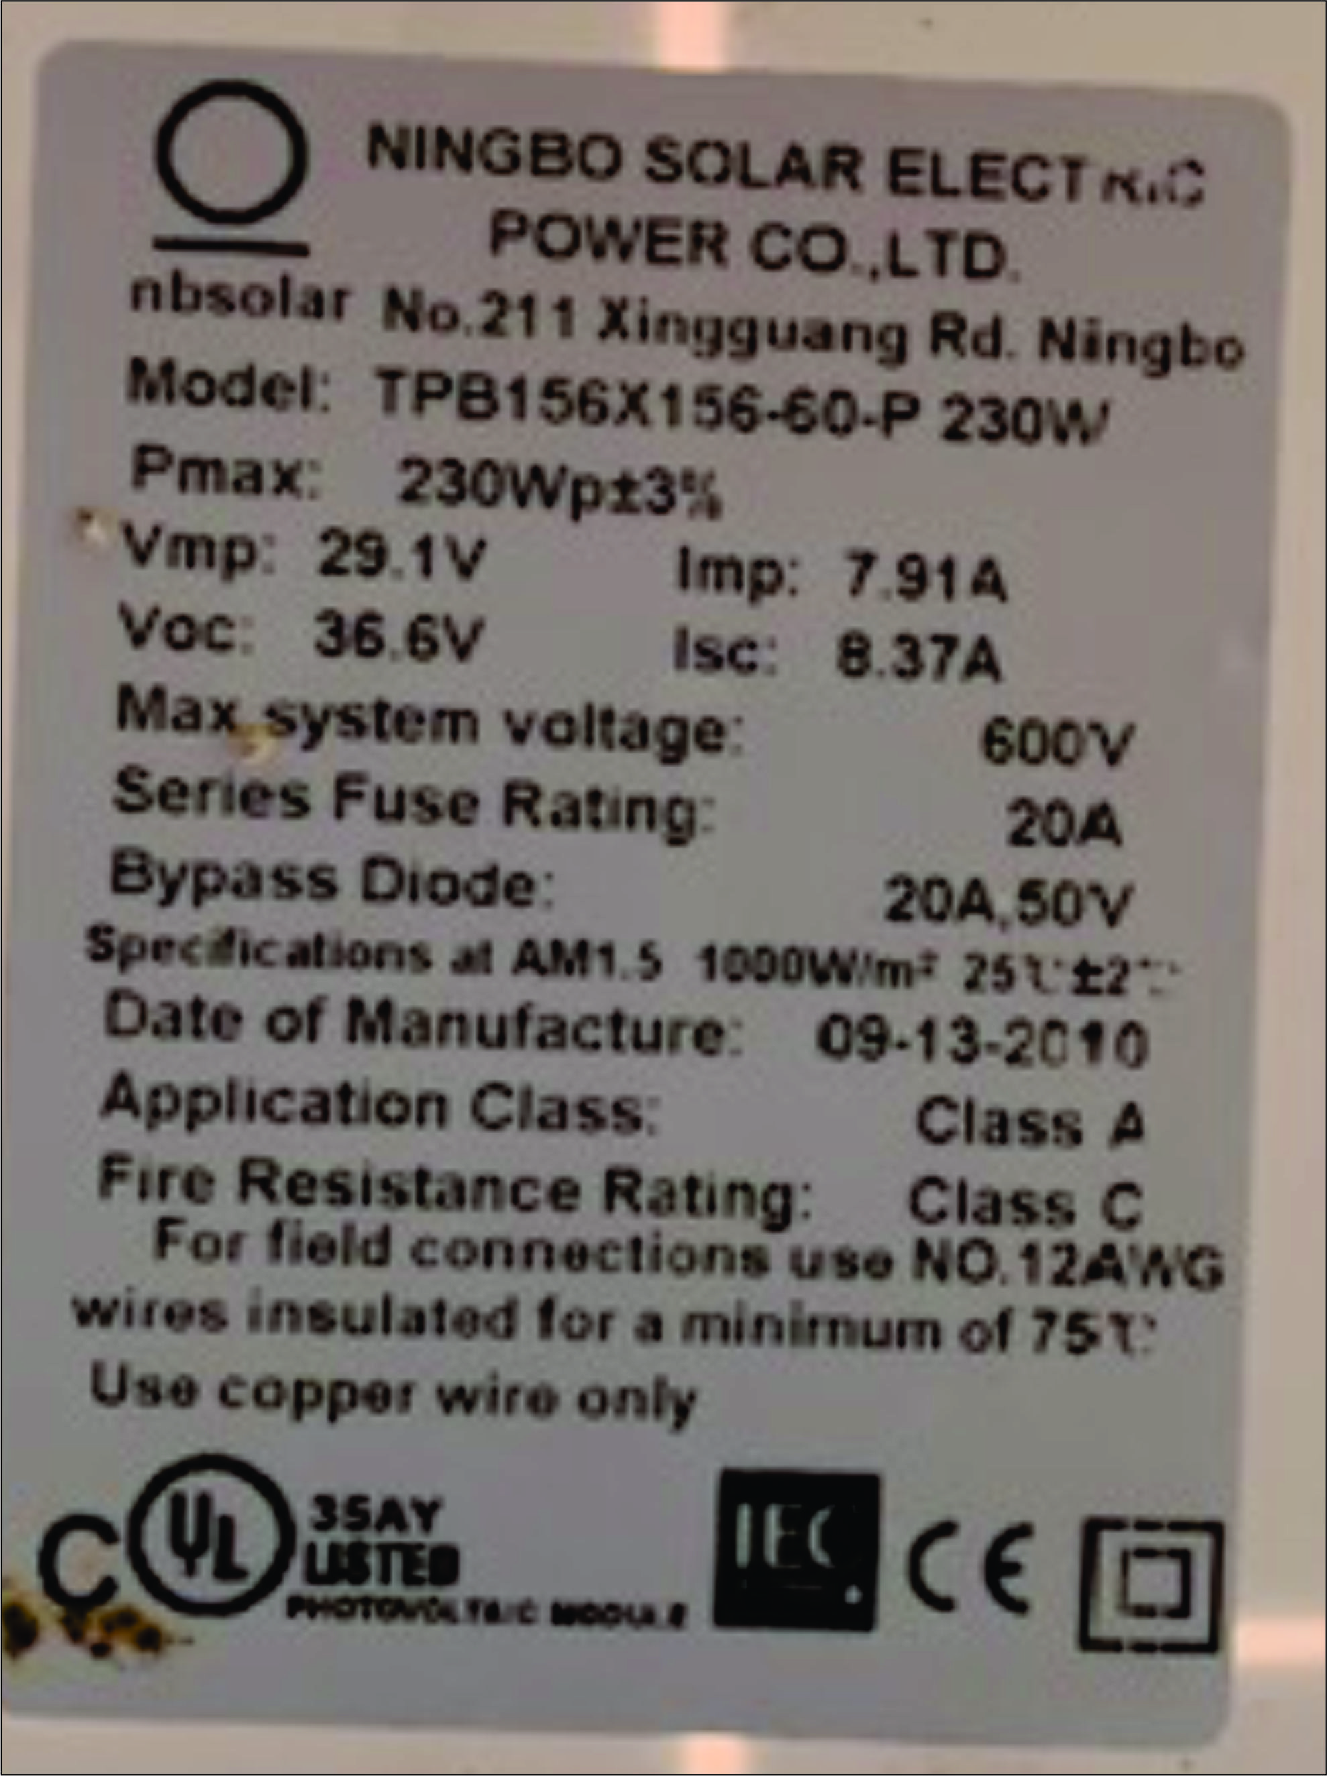
Labels on the back of each Panel tells the story

Slide 4
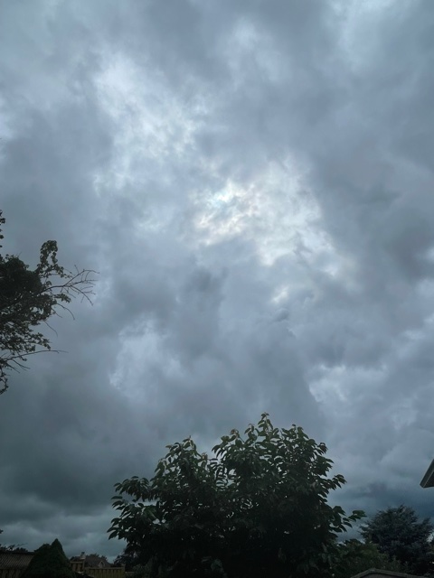
On this day Aug 1 2021 the skys are ready to open up to rain

Slide 5
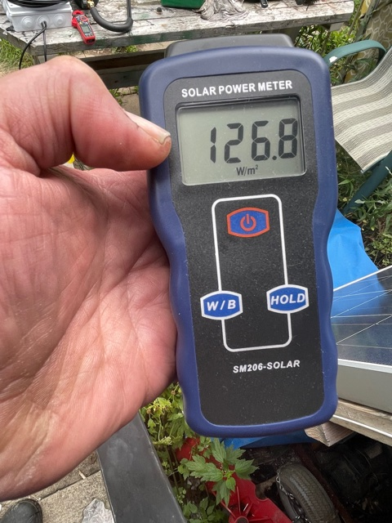
The solar power meter is reading 126.8 watts per sq. M

Slide 7
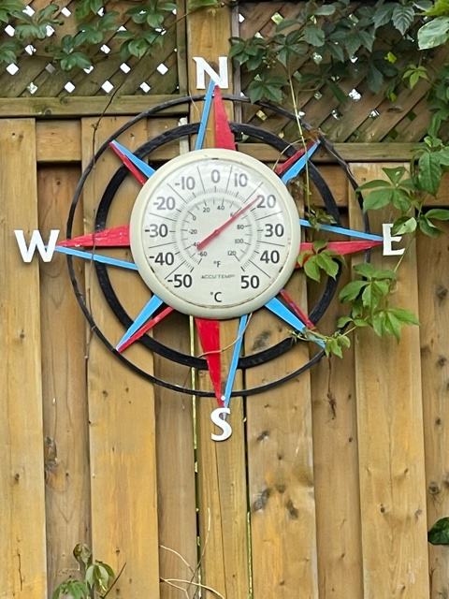
The outdoor temp. is about 18 degree C

Slide 8
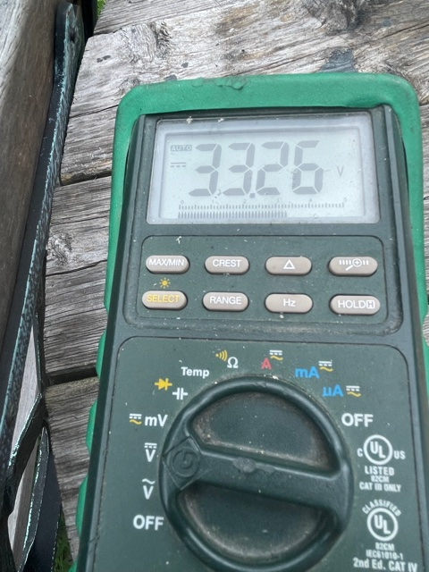
The open circuit voltage reads 33.26 volts DC

Slide 9
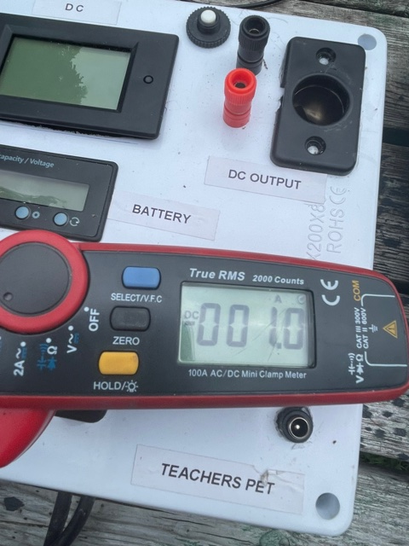
The short cct current is only 1 amp

Slide 10
The label says Isc which is current short circuit should be 8.37 A in max light

Slide 11
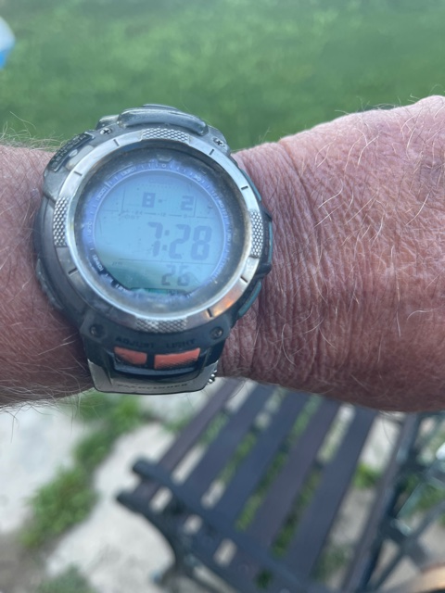
Aug 2 7:30am 15 degree

Slide 12
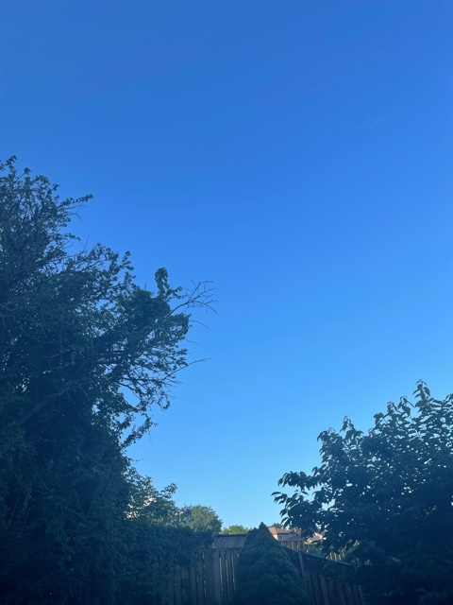
Sun not quite there yet

Slide 13
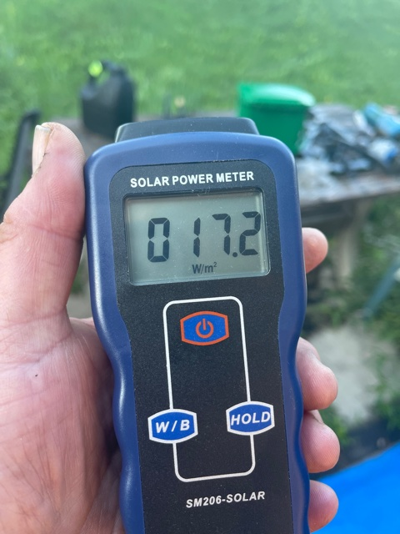
17.2 w/sq.M

Slide 14
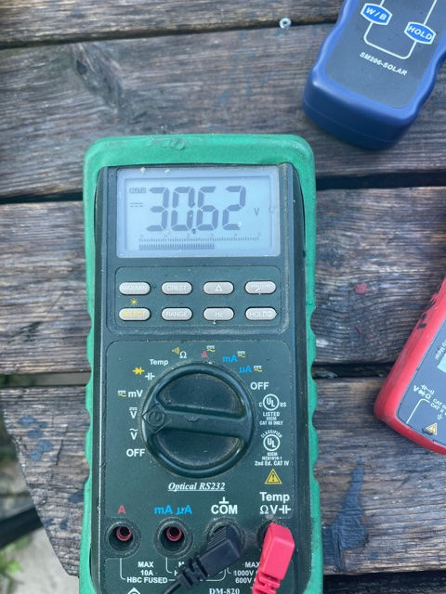

Slide 15
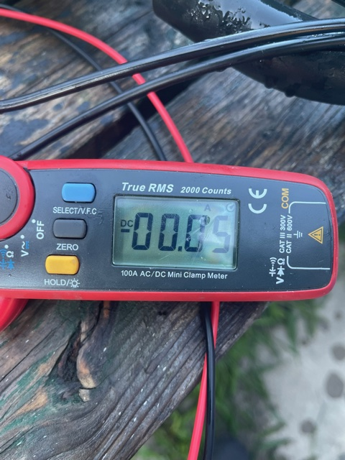

Slide 16
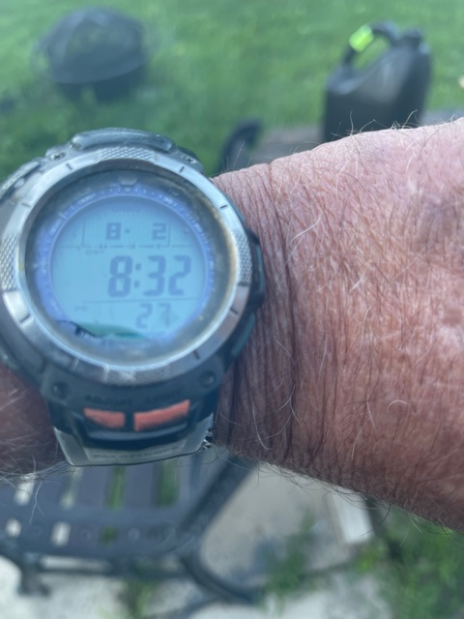
8:30 am

Slide 17
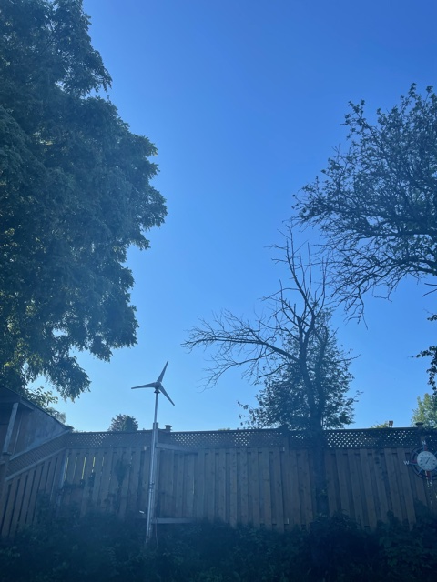
No real sun at work

Slide 18
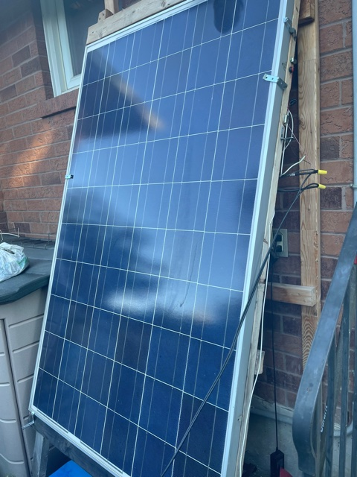
Nothing really on panel yet

Slide 19
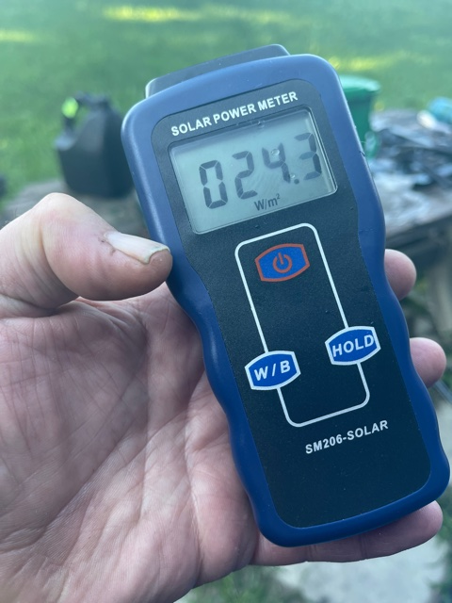
Slowly getting there

Slide 20
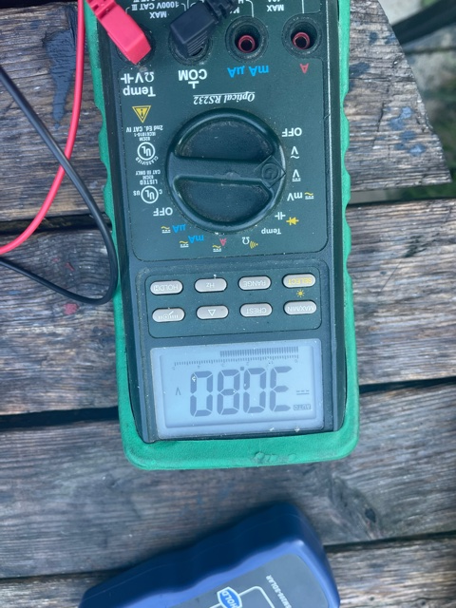

Slide 21
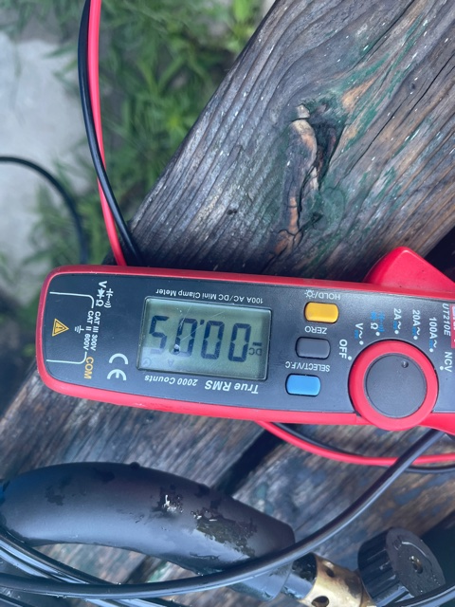

Slide 22
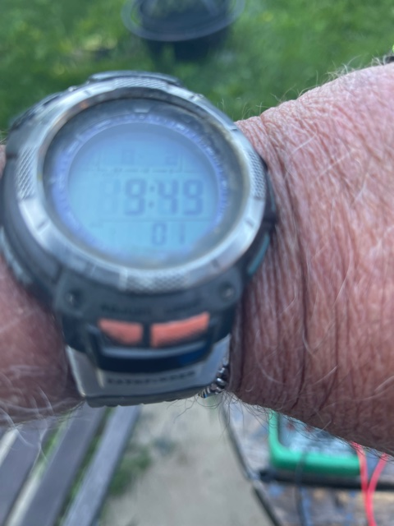
9:40

Slide 23
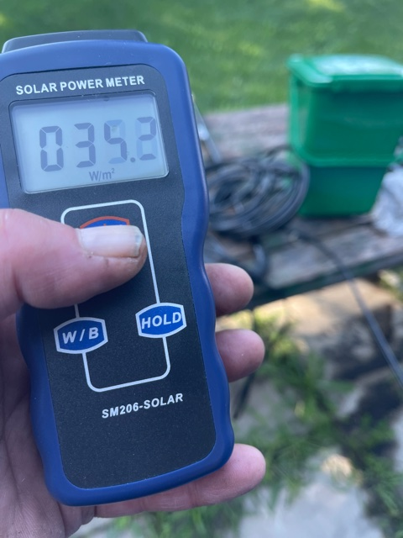

Slide 24
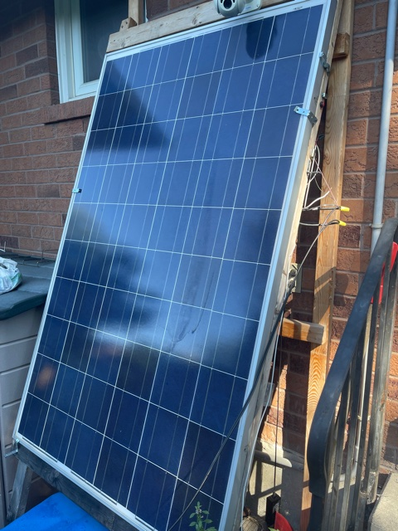

Slide 25
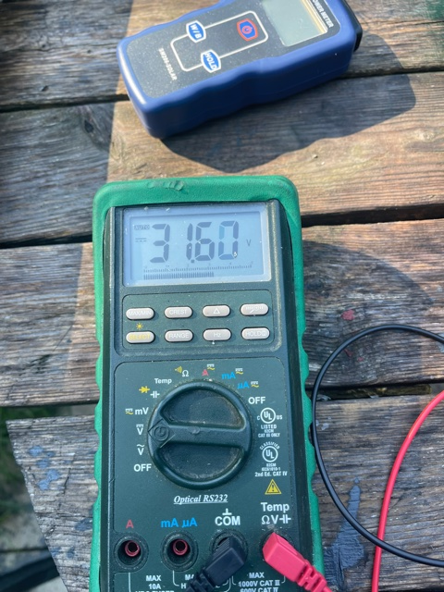

Slide 26
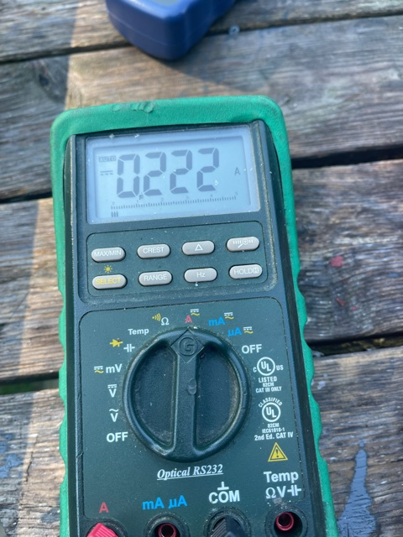

Slide 27
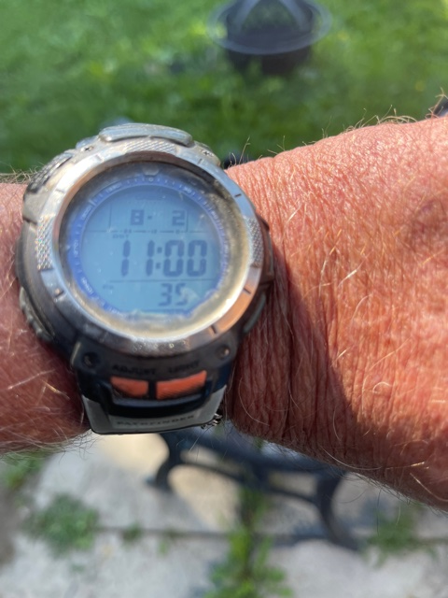
11 am

Slide 28
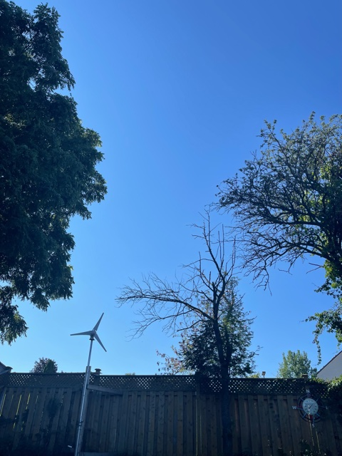

Slide 29
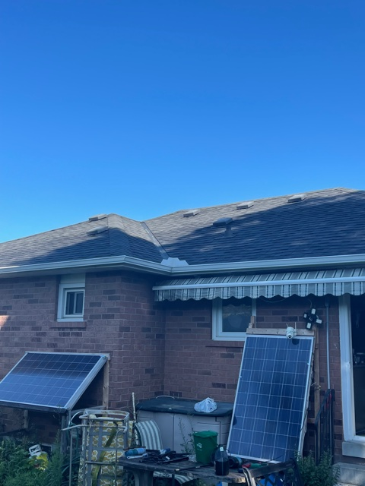

Slide 30
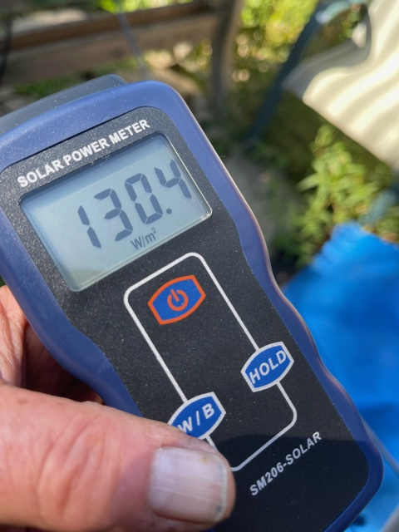

Slide 31
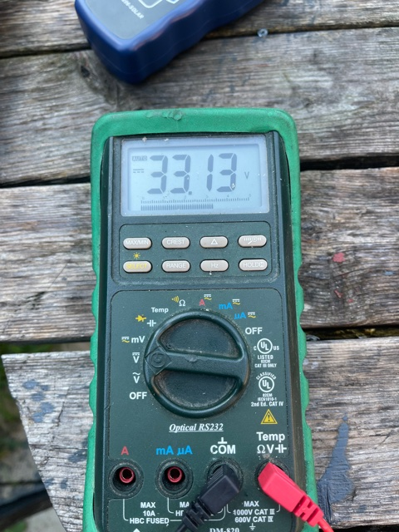

Slide 32
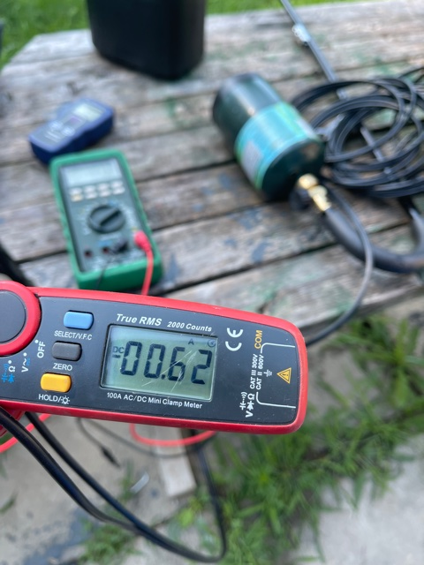

Slide 33
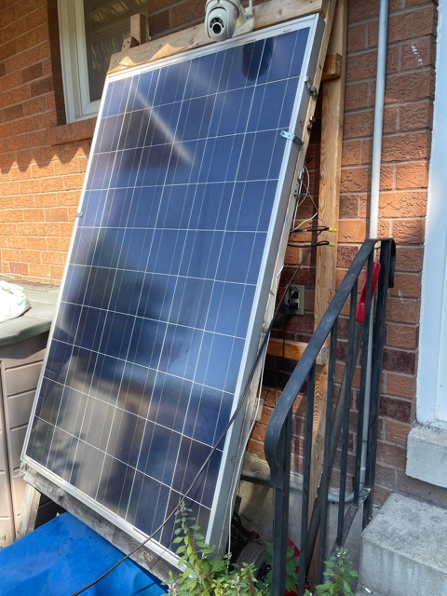

Slide 34
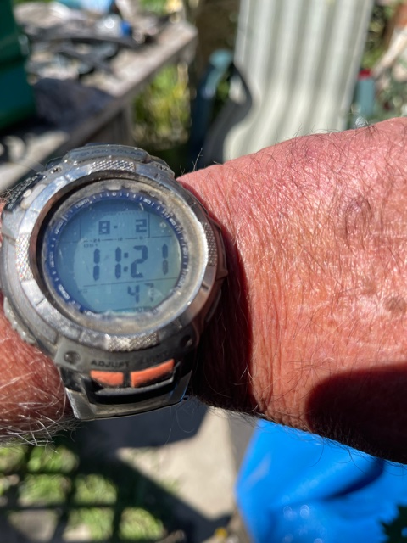

Slide 35
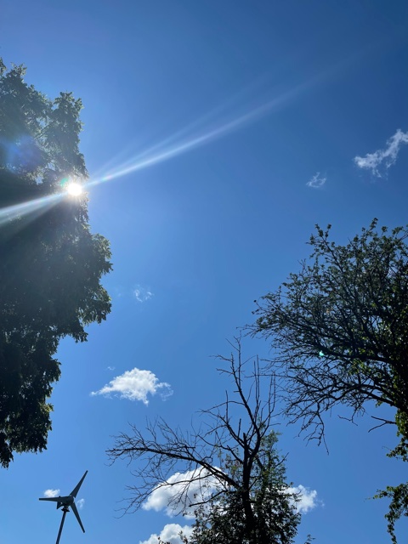

Slide 36
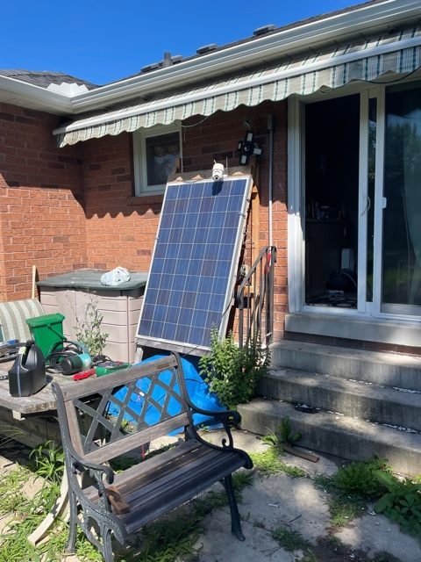

Slide 37
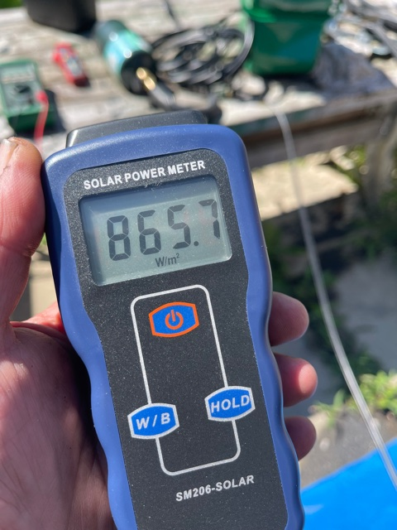

Slide 38
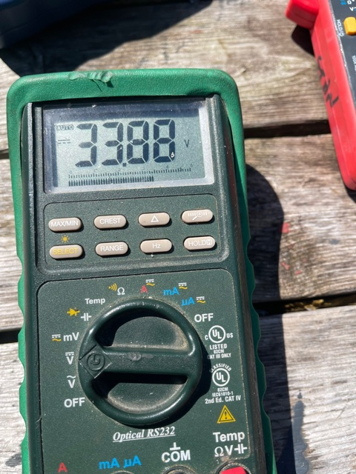

Slide 39
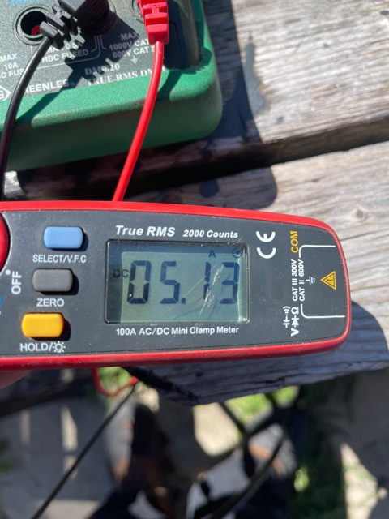

Slide 40
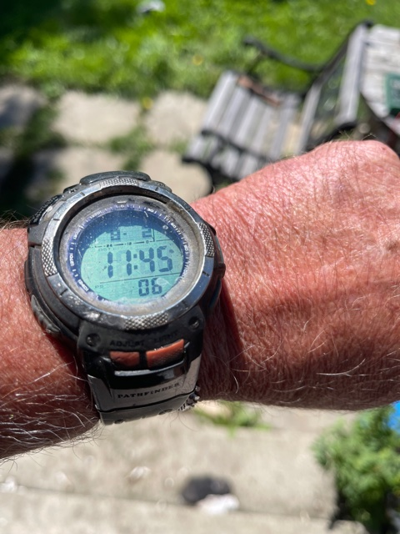

Slide 42
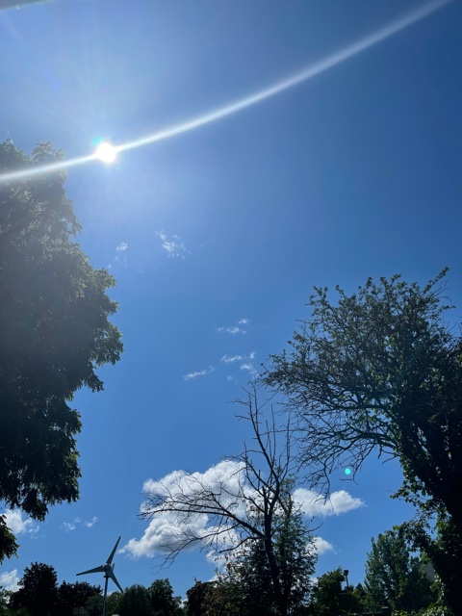

Slide 43
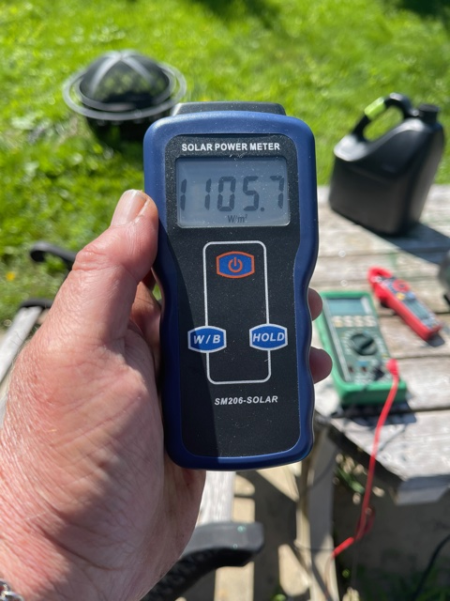

Slide 45
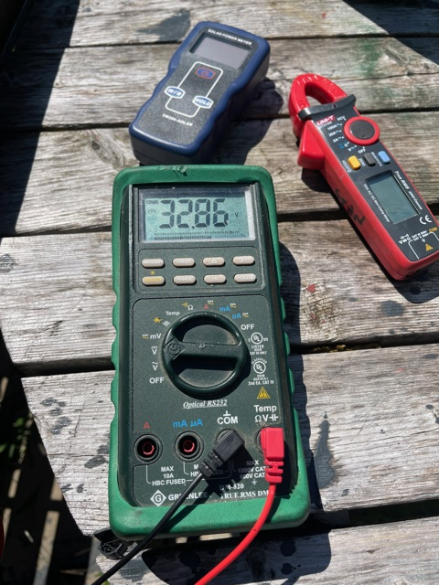

Slide 46
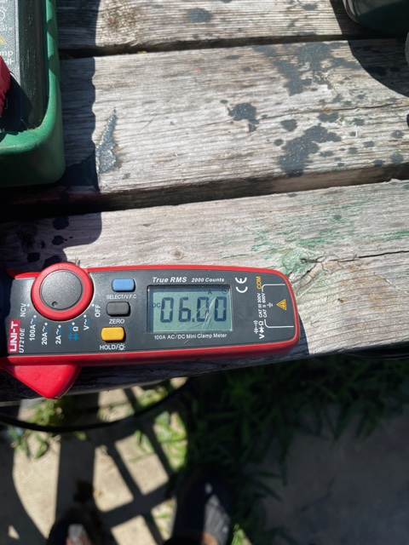

Slide 47
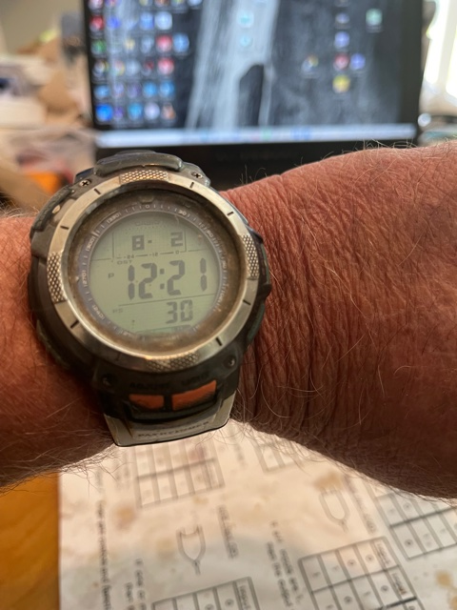

Slide 48
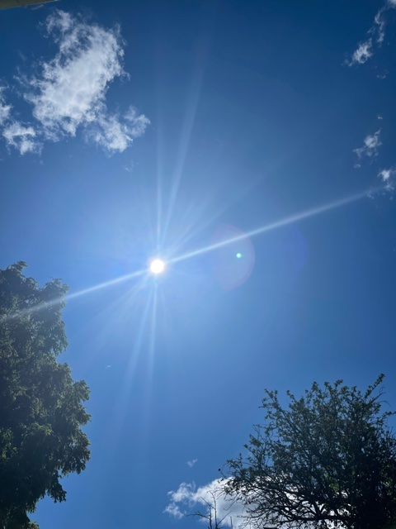

Slide 49
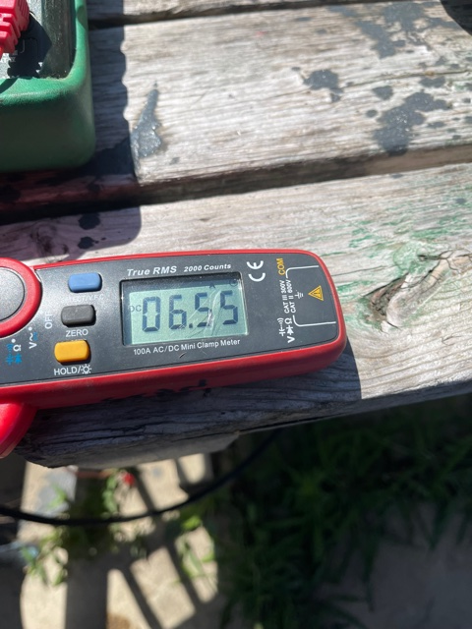

Slide 50
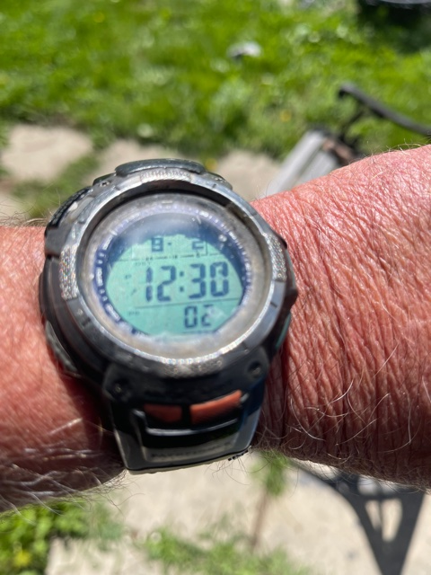

Slide 51
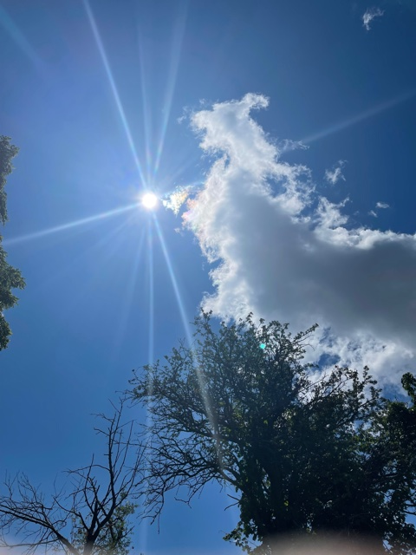

Slide 52
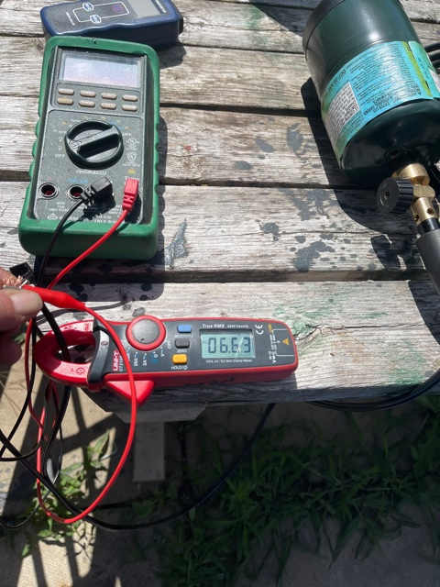

Slide 53
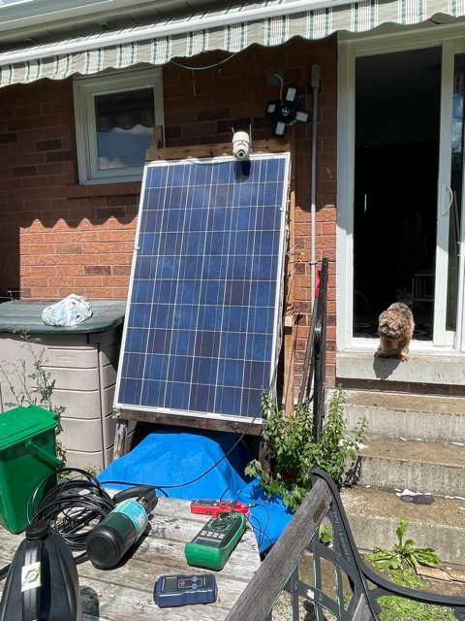
Quick rinse with water

Slide 54
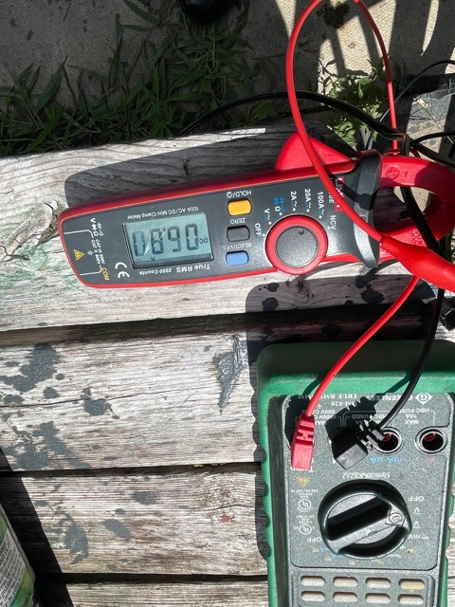

Slide 55
For the next few hours, it will be shaded
The foliage will be blocking the light for most of the afternoon until about 4 or so. When an
Angled sun will be available for another few hours…
This one panel charges my battery bank of about 80 AH and supplies enough power to control some lighting in my kitchen and back hall as well as emergency lighting if needed.

Slide 56
In the winter, I get more of a solar window
The solar window is the amount of sunlight hitting the panel during the day, the reason why I get more of a solar window is because there are no leaves on the trees….
the cleaner the panels, the more wattage it can produce and the better the angle, the more it can produce… this panel is not set for 30 degree, it is about 20 degree.. I do not change that because I use it to protect a device from t he weather…

